Slide 1


VN Habit Tracker
-VHT-
Supervisor: Lại Đức Hùng
Member:
Lưu Thành Đạt (Leader)
Nguyễn Hữu Thắng (Member)
Phạm Thanh Tùng (Member)
Nguyễn Quang Tuyến (Member)

Slide 2
AGENDA
1
Introduction
2
Issues
3
Idea & Solutions
4
Outcome
4
Future plan

Slide 3
1. Introduction
Habits are routine behaviors done on a regular basis. They are recurrent and often unconscious patterns of behavior and are acquired through frequent repetition. Many of these are unconscious as we don’t even realize, we are doing them.
Good habits are hard to develop when we use the typical tactic of trying to pump up our motivation to overcome our psychological resistance. Research has shown that motivation is an ineffective factor or creating lasting behavior change. Fortunately, we have also build an excellent alternative, which is called VHT. It let us tunnel right through the resistance barrier.

Slide 4
2. Issues
Everyday our lives are governed by habit. These habits are the little routines and small ways of doing things.
Most people are unaware or are only slightly aware that they’re doing them.
VHT helps you to set goals, keep track of your habits and tackle your bad habits.

Slide 5
Case study:

Slide 6
3. Idea & Solution:
3.1 Our ideas
3.2 Issues
3.3 Solution

Slide 7
3.1 Our ideas
We will develop an application which can be made for daily use, so you get a very clear overview of all your good and bad habits. By keeping a habit tracker, you are more conscious of your behaviors. You know actually what you are doing, more importantly, what not, what you should do. Without this tracker it can be very easy to believe you are indeed doing everything you want, but in the meantime, secretly, you are not. The tracker is a tool to transform your goals into good habit.

Slide 8
3.2 Issues

Slide 9
3.3 Solution
Our proposed solution is to build an application called “VN Habit Tracker” to resolve the current problems. The application collects (in real-time) all habits from customer. Moreover, it specifically helps them to track their habits daily, weekly and monthly. This application motivates them by showing the notification and reminder which depend on their setting. Customer can check their currently process. We also design the app which has statistics that helps customer to see their efforts.

Slide 10
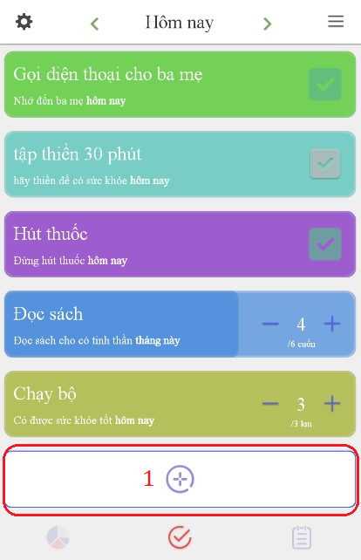
How to add a new habit

Slide 11
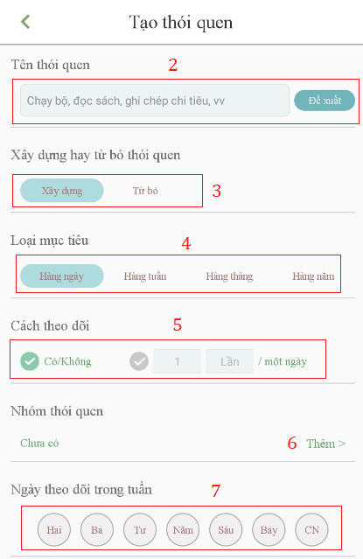
How to add a new habit

Slide 12
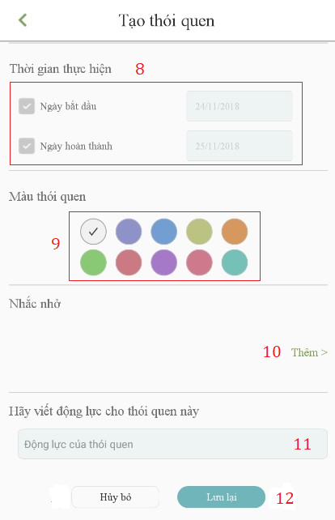
How to add a new habit

Slide 13
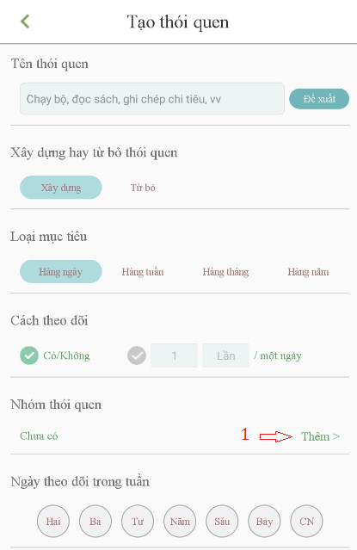
How to add group

Slide 14
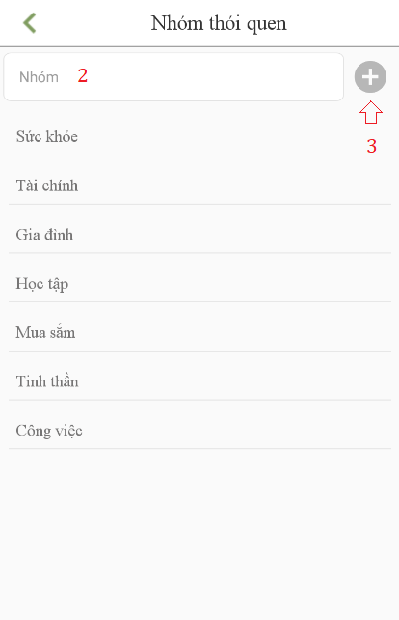
How to add group

Slide 15
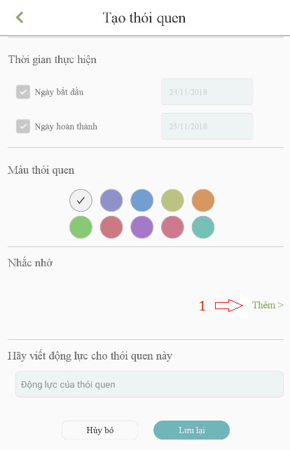
How to add reminder

Slide 16
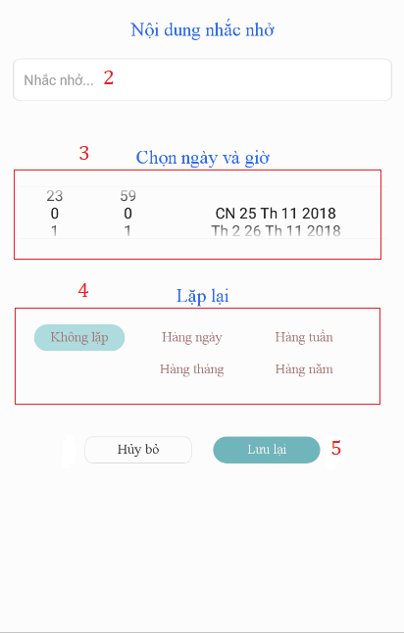
How to add reminder

Slide 17
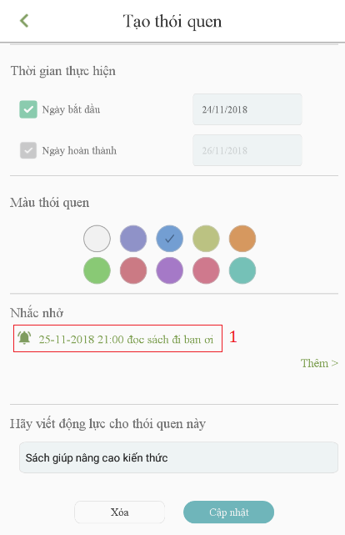
How to delete reminder

Slide 18
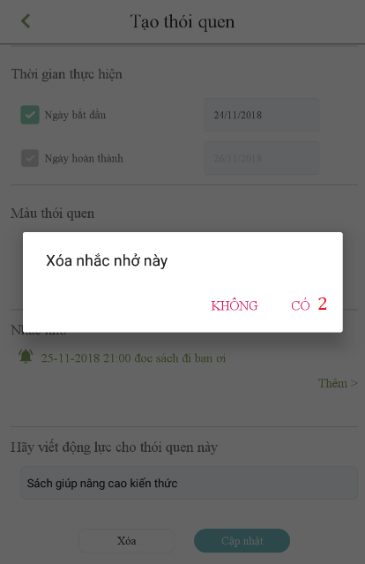
How to delete reminder

Slide 19
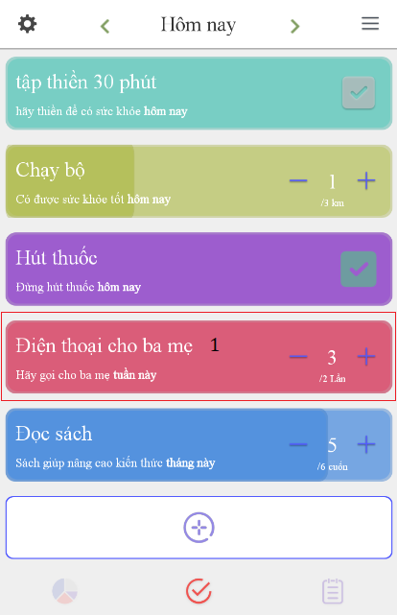
How to view statistic

Slide 20
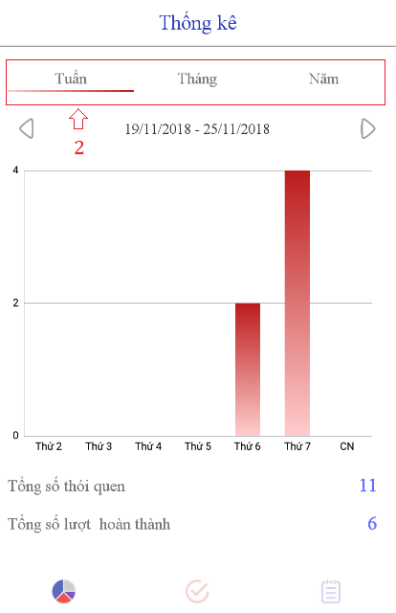
How to view statistic

Slide 21
How to edit & delete a habit

Slide 22
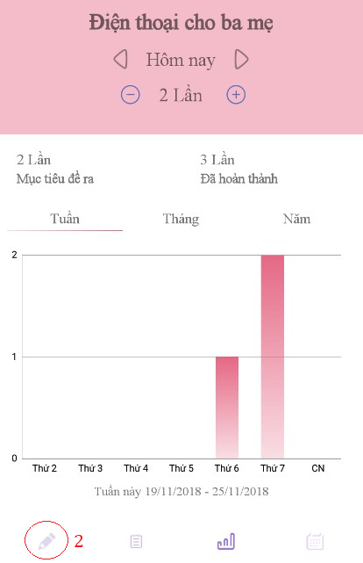
How to edit & delete a habit

Slide 23
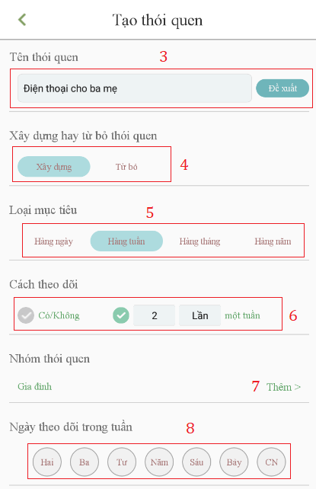
How to edit & delete a habit

Slide 24
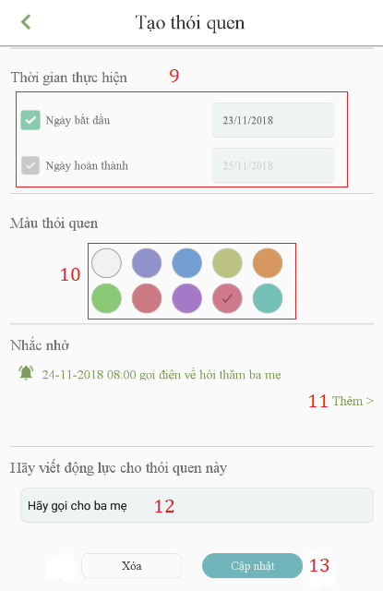
How to edit & delete a habit

Slide 25
How to view habit’s calendar

Slide 26
How to set filter

Slide 27
How to set setting

Slide 28
How to view user’s profile

Slide 29
How to add note

Slide 30
Demonstration

Slide 31
Approach
Nói về level của người dùng và cách tính toán cũng như những dữ liệu liên quan về việc này

Slide 32
How to solve the issue

Slide 33
Work flow

Slide 34
4. Outcome
Nói về những giá trị mang lại cho người dùng

Slide 35
5. Future plan
Nói về những điều mà app sẽ hiện thực sau này
GPS tracking, habit social network,… không implement nhưng phải có demo hướng đi cụ thể

